Slide 1
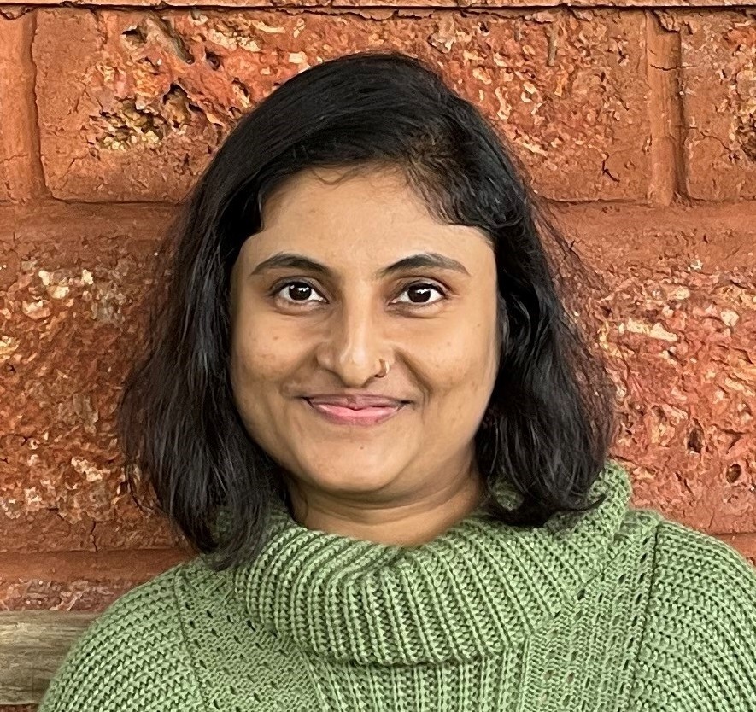
Apurva Lale, Assistant Project Manager
14 years of experience in IT field comprising of 8 years technical and 6 years of leading cross functional teams.
Certified Scrum Master helping teams by resolving impediments and facilitating ceremonies.
Experience in JIRA, Service Now and Confluence to track the progress and maintain transparency.
Agile Project Manager with experience in managing projects from initiation to closure.
Apurva.lale@brillio.com
Project Experience
Leaf Home: Integrations with Other Systems
Managing resources and capacity
Facilitating scrum ceremonies
Tracking progress by utilizing project management software like JIRA, Service Now, Confluence
Managing project risks, issues, and dependencies
Delivering weekly status reports highlighting key project metrics
Emerald : Application Support
Managing resources
Scrum process improvements along with scrum artifacts
CMMI documentation
Managing project, Risk/Issues/Dependency Management
Zscaler: Salesforce Sales, Service, CPQ clouds
Managing resources
Facilitation of scrum ceremonies
Scrum process improvements along with scrum artifacts
CMMI documentation
Managing project, Risk/Issues/Dependency Management
Core Skill Sets
Scrum
Kanban
Agile Project Management
JIRA
Confluence
Salesforce
CMMI
Certifications
Salesforce Certified Administrator
Certified Scrum Master
SAFe 5.0 Certified Scrum Master
Recent Roles
Scrum Master
Project Manager
Key Clients
Zscaler
Emerald
LeafHome
©2024 Brillio | 1

